Slide 1
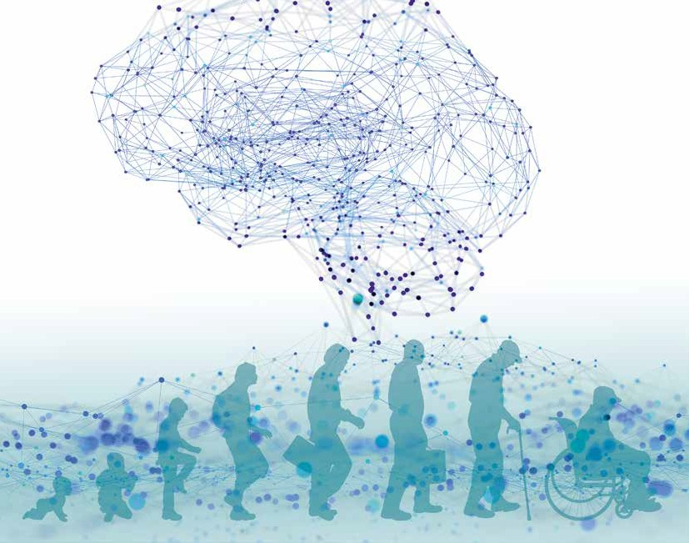
The German Brain Plan
Agenda 2030
Supporting brain health. Treating brain disease.
The roadmap to a brain healthy future in Germany.

Slide 2
It’s time to act for brain health!
It’s time to act for brain health!
The German Brain Council is presenting the “German Brain Plan – Agenda 2030” because stable human health is not possible without brain health.
Currently, 25 percent of all people worldwide have a neurological or mental illness, and these illnesses result in costs of more than 800 billion Euros annually in Europe alone.
Five examples covering the entire human lifespan, from stroke to depression, are presented to highlight these facts and ask for quick and effective help from policymakers and society to support research on better prevention and treatment.
5

Slide 3
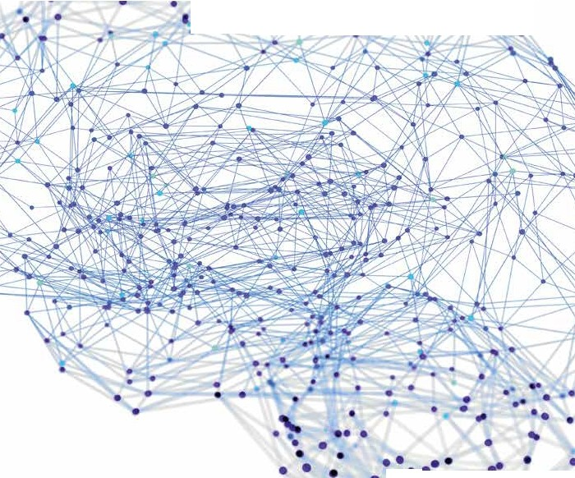
•
•
• •
• • •
•
•
•
•
•
.,
•
•• • •• •
•• •
•
•I!!
'
•
••
_{t} •.,•••
•
•
•
• •
•
•
•
Reasons why a German Brain Plan is important
•
••
•
Brain health is of great societal importance because …
Physical and mental health is not possible without a healthy brain.
One in three people is affected by a brain disease. This means individual suffering, loss of quality of life and autonomy and reduced productivity of hundreds of millions of people in Germany alone.
Brain health is the most important national resource for our society and a prerequisite for education, creativity, innovation and international competitiveness.
Brain diseases cause a high health economic burden. Brain diseases result in direct costs of over 60 billion euros per year for the health care system. This amount corresponds to almost 20% of all health spending. The total costs of brain diseases for the German national economy are at least three times higher.
Disorders at an early age can have effects throughout life, e.g., on education or life expectancy.
•
•
•
•
•
·
•
•
•
•
••• •
•••
..
•
•• •
•
...
•
•
..
•
• ..•
•..
•
,

Slide 4
•
•
• •
• • •
•
•
•
•
•
.,
•
•• • •• •
•• •
•
•I!!
'
•
••
_{t} •.,•••
•
•
•
• •
•
•
•
Brain research must be adequately strengthened and better financed because …
The complexity of the brain is nowhere near fully understood.
The translation of research findings into therapeutic strategies is still unsatisfactory and needs to be improved.
New, ground-breaking ideas and treatments (e.g., antisense therapies, molecular therapies, network therapies) have been applied only in in- dividual cases but most of them are still waiting to be implemented and promise great leaps in knowledge.
New treatment concepts can be improved through translation and back translation.
Interdisciplinary configurations must be better promoted, for example between neuromedicine and data engineering or in the transition from dolescent to adult medicine.
Structured promotion of the excellent academic potential in Germany could lead to a significantly better expansion of research.
The roughly 4 million people with approx. 6800 rare diseases (orphan diseases) should also benefit from research.
•
••
•
•
•
•
•
•
·
•
•
•
•
••• •
•••
..
•
•• •
•
...
•
•
..
•
• ..•
•..
•
,
•
•
..
•
•

Slide 5
•
•
• •
• • •
•
•
•
•
•
.,
•
•• • •• •
•• •
•
•I!!
'
•
••
_{t} •.,•••
•
We advocate …
Life-long, good brain health, prevention and better quality of life,
Patient-oriented health and care services that also consider the en- vironment of patients and their relatives,
Good care and the best possible participation right from the start of symptoms to diagnosis, treatment and rehabilitation
Improved knowledge and quality through research and innovation.
•
•
• •
•
•
•
•
••
•
•
•
•
•
•
·
•
•
•
•
••• •
To do this, we need …
Political support for a national strategy for brain health throug- hout the human lifespan
Prioritisation of funding for the development of translational health programmes for the treatment of brain diseases
Long-term and adequate funding of research on brain functions and diseases amounting to 10% of the overall public health research funding
Destigmatisation of people with brain diseases
Support programmes for relatives of people with brain diseases
Greater awareness in society of the topic of brain health
•••
..
•
•• •
•
...
•
•
..
•
• ..•
•..
•
,
•
•
..
•
•

Slide 6
18 million people
798 billion Euros
In 2010, the total cost of brain disorders in Europe was 798 billion euros, of which 37% weredirect health costs, 23% direct, non-medical costs and 40% indirect costs. The average cost per citizen was €5,550.
Global costs of mental and neurological diseasesn
2010 and 2030 (forecast), in trillions (US$)
2030
(forecast)
in Germany, have a mental illness,
of whom about 10 million
have an anxiety disorder and about million have depression.
2010
According to estimates from the World Economic Forum, in 2010 mental and neurological disea- ses caused costs of 2.5 trillion US dollars.
Psychiatric and neurological diseases affect all age groups – from childhood to old age, e.g., depression, which must be increasingly treated in young people aged 15 and younger.
2.5
6
Source: Statista, forecast from 2012

Slide 7
Brain health over the human lifespan exemplified by 5 brain diseases
The fields of neurology and psychiatry perform research on, diagnose and treat several hundred diseases, including numerous well-known diseases such as Parkinson’s disease, multiple sclerosis, epilepsy and alcohol dependence, to name just a few. In addition to the widespread diseases, there are also thousands of rare diseases. New challenges, such as long COVID, add to the spectrum of brain diseases.
5 diseases – 5 representative examples
from adult, pediatric and adolescent medicine
Traumatic brain injuries in children, adolescents and adults
Alzheimer’s dementia as an example of a degenerative disease
Depression in children and adults
5q-linked spinal muscular atrophy as an example of a rare disease
Stroke in children and adults

Slide 8
•
•
• •
• • •
•
•
•
•
•
.,
•
•• • •• •
•• •
•
•I!!
'
•
••
_{t} •.,•••
•
•
•
• •
•
•
•
•
••
Health– and disease-span topics
•
•
•
•
•
Prevention and rehabilitation
•
·
•
E-health, digitalisation, telemedicine
•
•
•
••• •
•••
..
•
•• •
•
...
•
•
E-health is strategically divided into:
General organisational applications with data protection and data exchange (e.g., electronic health card, electronic patient records, hospital information systems)
Specific telemedicine applications (e.g., digital health applications and video treatment)
..
•
• ..•
•..
•
,

Slide 9
THE ROADMAP – AGENDA 2030
2022/2023
Raise public awareness of the German Brain Plan and networking. Identification
of deficits in care.
2024/2025
Pilot projects on traumatic brain injury and depression. Promotion of early diagnosis, treatment and rehabilitation.
2026/2027
For all diseases, implementation of research findings in clinical practice: improvement of treatment success and recovery of functions.
2028/2029
Continuous expansion of project topics.

Slide 10
German Brain Council
Executive Committee of the GBC
Prof. Dr. med. Peter Falkai (Munich) President of the GBC 2020–2021
Prof. Dr. med. Agnes Flöel (Greifswald) Committee Member GBC
Dr. phil. Katharina Glanz, MScPH (Munich, patient representative) Secretary GBC
Prof. Dr. med. Christian Mawrin (Magdeburg) Treasurer GBC
Prof. Dr. med. Thomas Mokrusch (Lingen) Vice president GBC 2022–2023
Prof. Dr. rer. nat. Christine R. Rose (Düsseldorf) Committee Member GBC
Prof. Dr. med. Ulrike Schara-Schmidt (Essen) President of the GBC 2022–2023
Prof. Dr. med. Alfons Schnitzler (Düsseldorf) Founding president of the GBC 2018-2019
www.braincouncil.de
Contributors
Prof. Dr. med. Jürgen Deckert Prof. Dr. Götz Thomalla
Prof. Dr. med. Martin Dichgans Prof. Dr. Robert Perneczky
Dr. rer. medic. Gabriel Gerlinger Prof. Dr. med. Gerd Schulte-Körne
PD Dr. med. Lucia Gerstl Prof. Dr. med. Jörg-Christian Tonn
Prof. Dr. med. Prof. h.c. Florian Heinen Prof. Dr. med. Andreas Reif
Prof. Dr. med. Andreas Meyer-Lindenberg Prof. Dr. med. Maggie C. Walter
PD Dr. med. Nicole Terpolilli
The German Brain Plan Agenda 2030
Get your digital copy by scanning this QR code:

Slide 11
Thank you for your attention

